Slide 1

Request Mast Program
SgtMaj T. M. Babcock

Slide 2
Overview
Purpose of Request Mast
Request Mast Policy
Chain of Command
Request Mast Procedures
Follow up Procedures

Slide 3
Purpose of Request Mast
Request mast is the primary way for a Marine to formally seek assistance from, or communicate a grievance to, his or her commander. Although a Marine’s request mast may not be resolved to his or her satisfaction, the Marine shall be afforded the opportunity to address the issue with the commander. Personnel outside the official chain of command shall not conduct request mast. Only designated commanders as outlined in chapter 1 of this Order will conduct request mast. Other personnel such as subordinate officers, civilians, noncommissioned officers (NCOs), or staff noncommissioned officers (SNCOs) must not delay the request mast process in order to address the grievance or issue themselves. They will focus their efforts on making the Marine available to the commander and provide assistance to ensure the entire process is efficient and completed without delay.

Slide 4
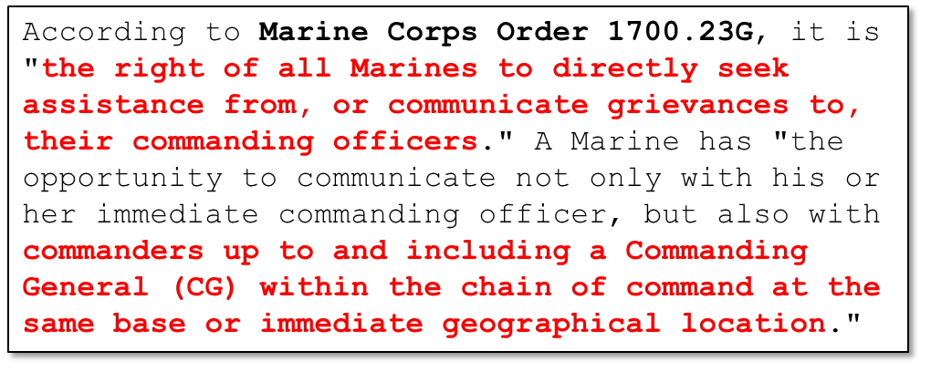
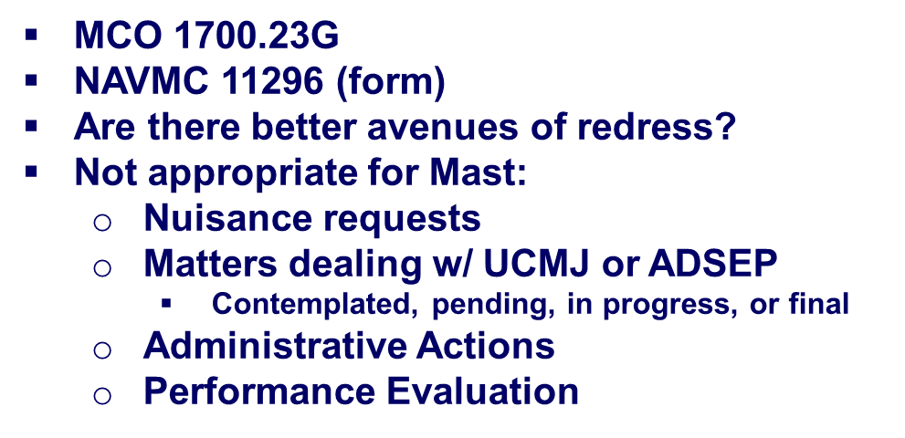
Request Mast Policy
A commander may deny a Request Mast if there is another specific avenue of redress available to the Marine such as:
- Actions under the UCMJ: Appeal Process
- Involuntary Administrative Separation: Request ADSEP Board if eligible, Board for Correction of Naval Records and the Naval Discharge Review Board
- Complaints under Article 138 (Complaints of wrongs) of the UCMJ by the Commanding Officer and Article 1150 (Redress of Wrong Committed by a Superior)

Slide 5
Request Mast Policy
MCO 5354.1E (MARINE CORPS PROHIBITED ACTIVITIES AND CONDUCT
PREVENTION AND RESPONSE POLICY) describes the primary methods for submitting and adjudicating complaints concerning harassment (to include sexual harassment), unlawful discrimination and abuse, wrongful distribution or broadcasting of intimate images, and certain dissident and protest activity. A Marine may use request mast to present these types of complaints as an alternative, but the procedures described in reference MCO 5354.1E remain the primary means.

Slide 6
Request Mast Policy
Any Marine requesting mast to his or her CG has the option to do so confidentially. If the Marine does not desire to reveal the subject of the request mast to subordinate commanders in the chain of command, the Marine must include a statement as to why the subject was not revealed in the request mast. The Marine shall place the NAVMC 11296 and any supporting documentation in a sealed envelope marked “to be opened by the CG only.” The Marine’s first commander in his or her chain of command shall receive any request mast sealed and marked “to be opened by the CG only.” Each intermediate commander shall offer to understand and attempt to resolve the issue or grievance. If the Marine maintains that he or she does not desire to reveal the subject, each of the Marine’s commanders in his or her chain of command shall forward the request mast to the next higher level of command until it is delivered to the CG or the RMRA.

Slide 7

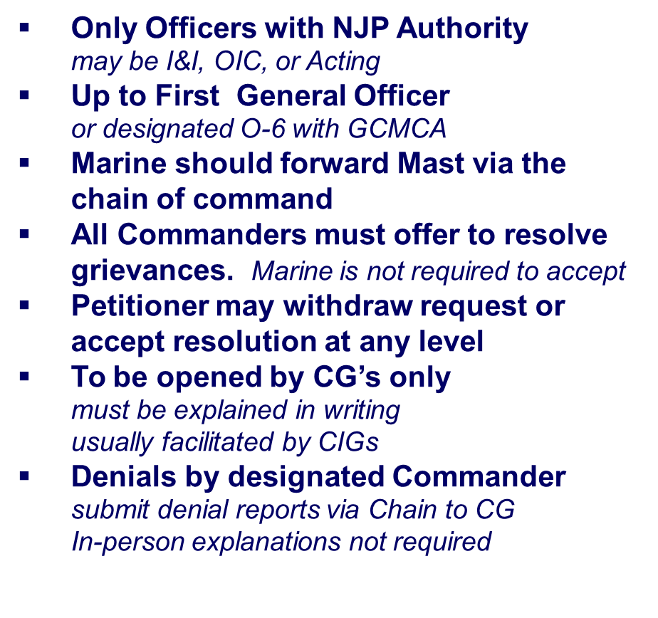





The Chain of Command
Request Mast Reviewing Authority (RMRA). A person designated by a CG to examine requests mast that are sealed and labeled, “to be opened by the CG only.” The RMRA may review the materials for accuracy and sufficiency but may not deny the request mast on behalf of the CG. May make appropriate recommendations to the CG that pertain to the request mast application
*
*Command Inspector General (CIG)

Slide 8



MASS-1 Request Mast Flow Chart
Process and resolve a Marine’s request mast without delay. There should be no more than one working day delay from when the request is presented to when the Marine has an audience with the commander. This applies at each level of the command.
CG, 2D MAW MAJGEN CEDERHOLM
CO, MACG-28 COL MCCARTHY
Commanders who receive legitimate grievances or requests for assistance via request mast shall forward those beyond their authority to resolve to the next higher commander for resolution.
CO, MASS-1 LTCOL COATES

Slide 9
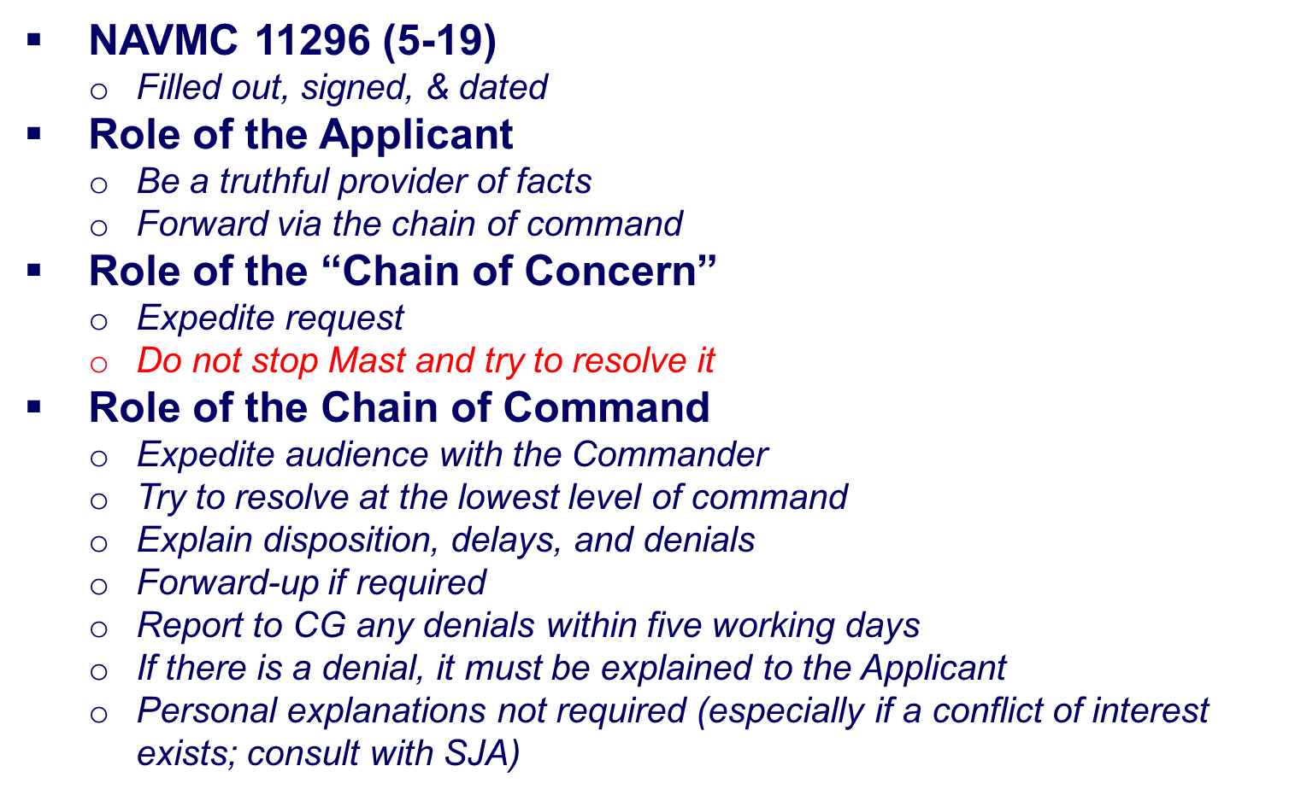
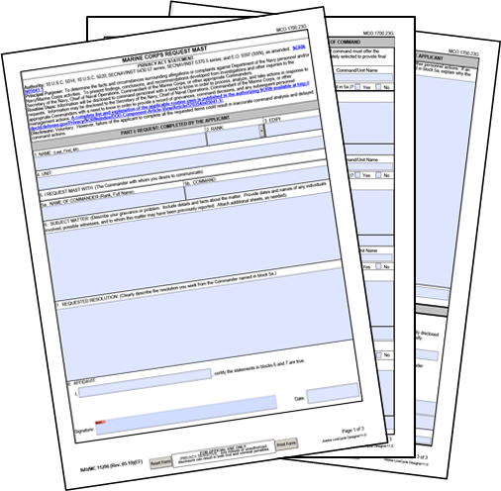
Request Mast Procedures

Slide 10

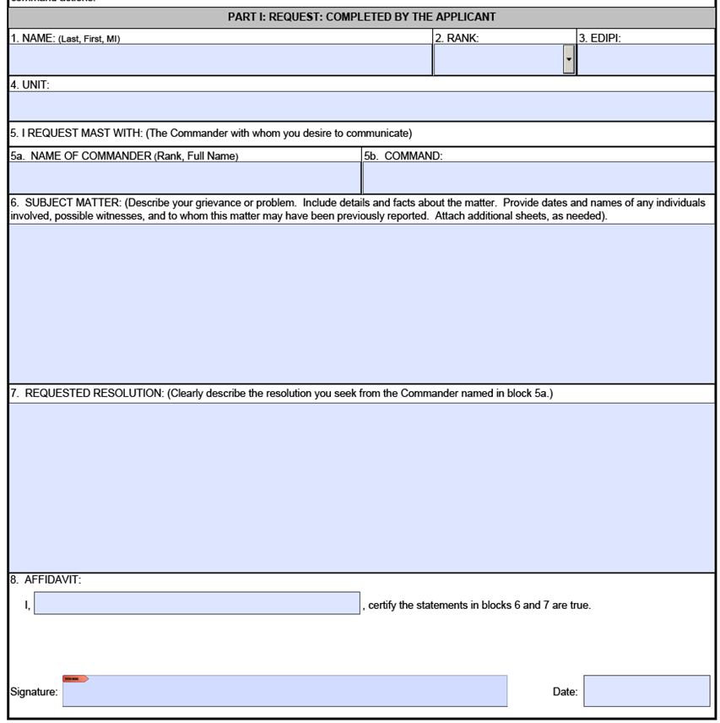



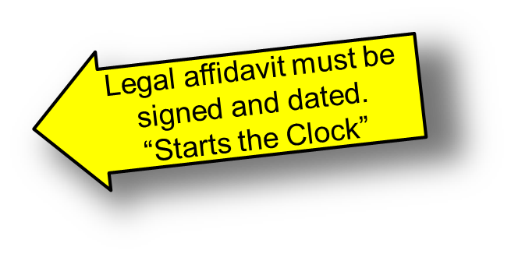
Request Mast Procedures
Part 1 Completed by Marine Requesting Mast!!!

Slide 11

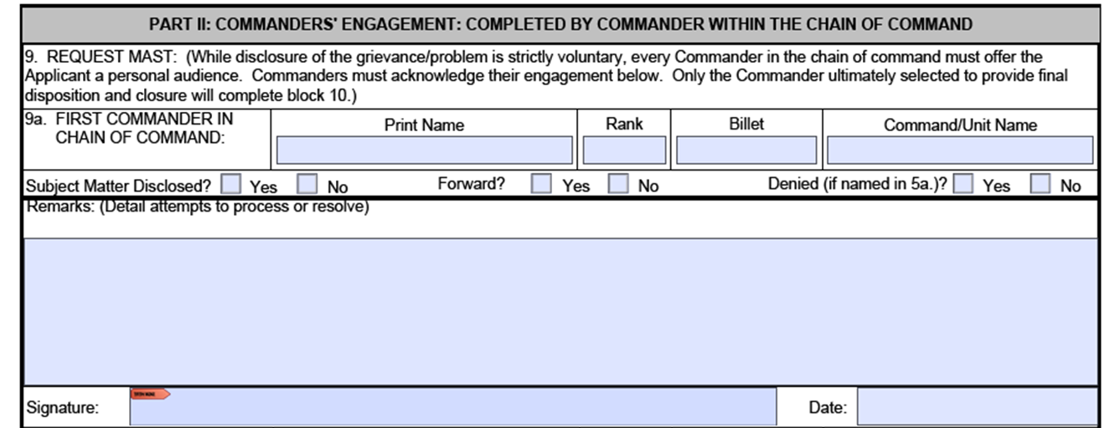



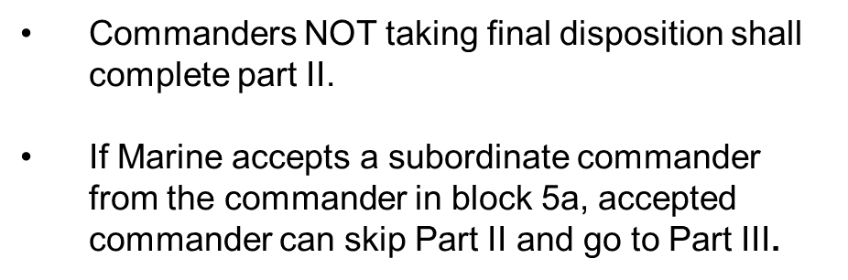
Request Mast Procedures

Slide 12
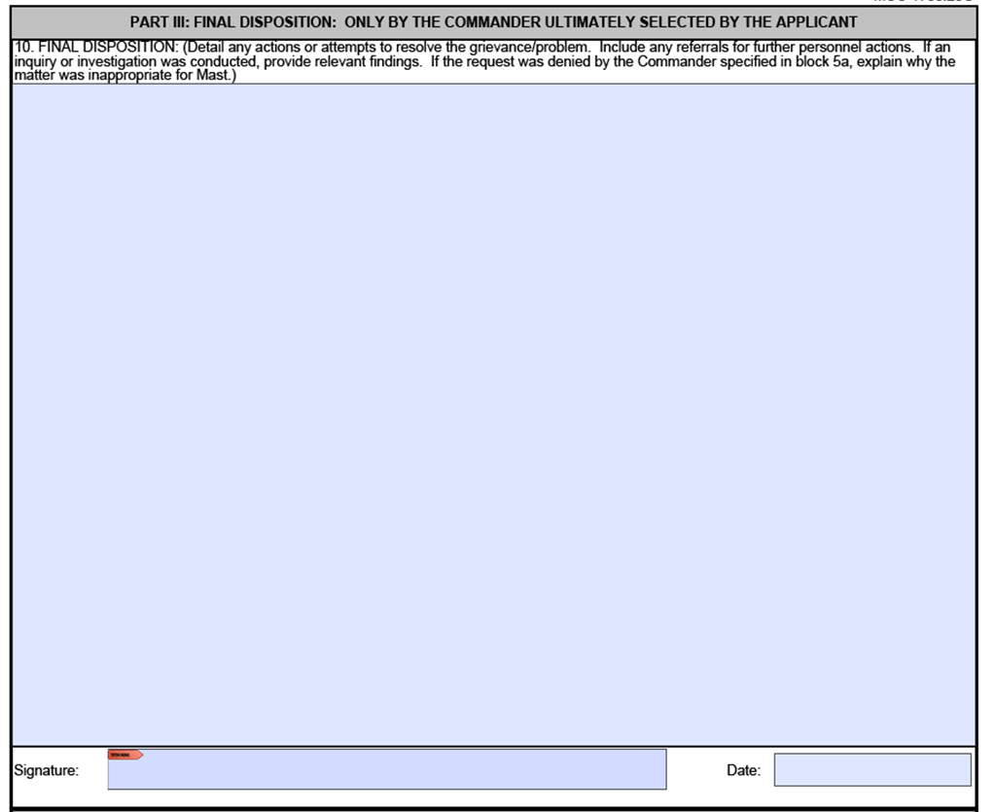
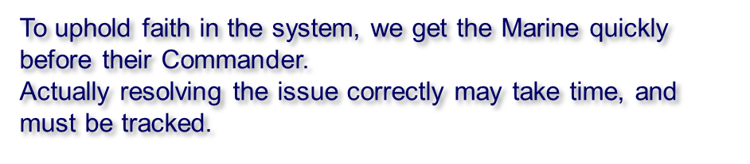

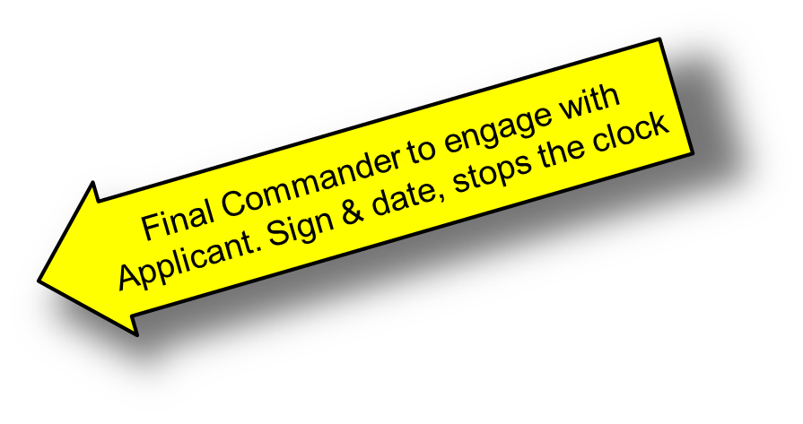
Request Mast Procedures

Slide 13

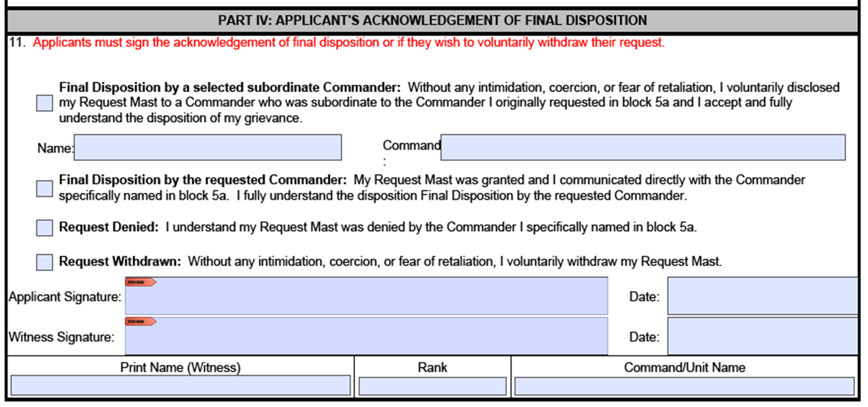




Request Mast Procedures

Slide 14
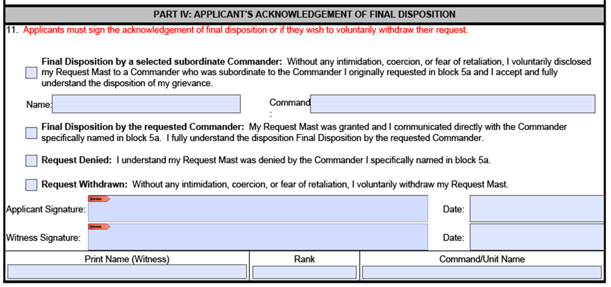

Request Mast Procedures

Slide 15

Request Mast Procedures

Slide 16
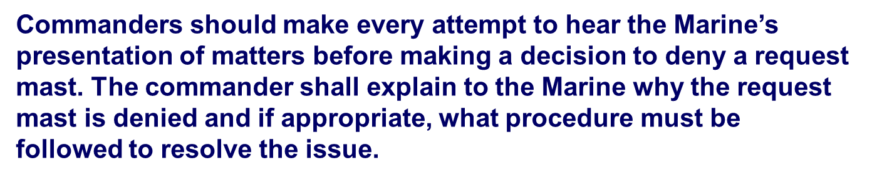
Request Mast Procedures

Slide 17

Request Mast Procedures

Slide 18
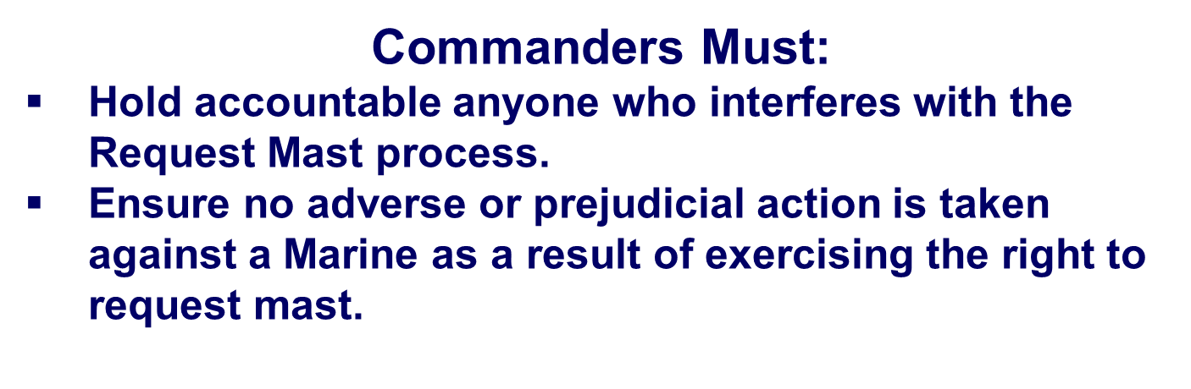

Request Mast Procedures

Slide 19
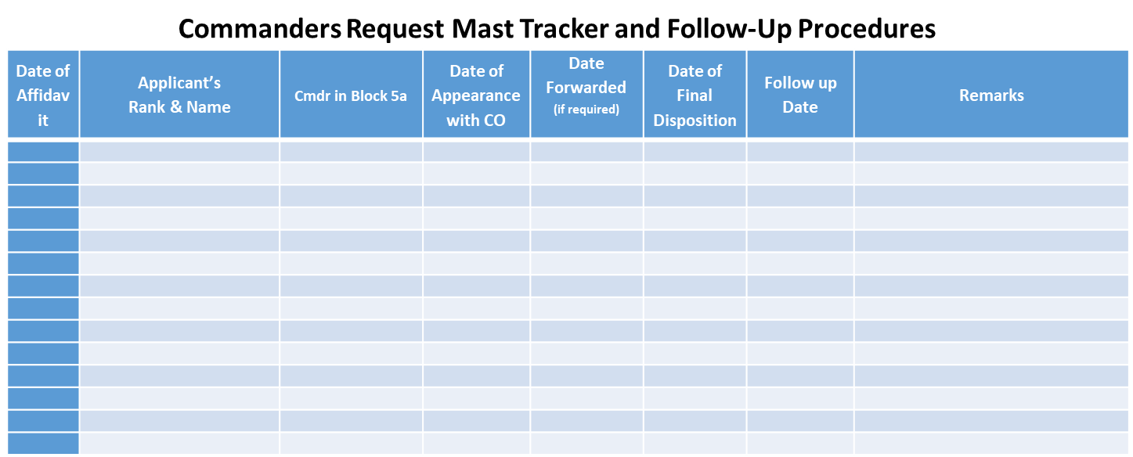
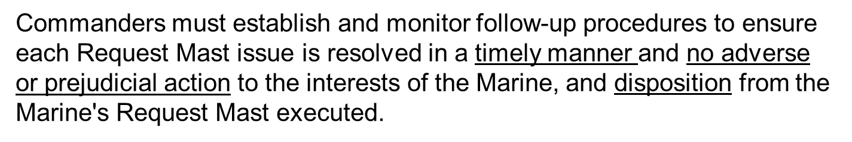
Follow up Procedures

Slide 20
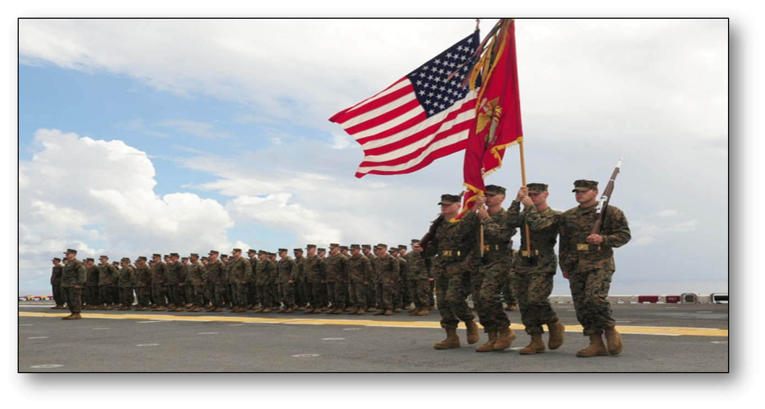
Questions

